Slide 1
异步组件
@刘信强
2018-03-12
Async
Async

Slide 2
应用场景

Slide 3
A
C
I
B
D
G
C
F
K
D
G
M
E
H
C
Project I
Project II
Project III
公有组件 && 公有逻辑 && 公有样式

Slide 4
公有头部
LocalStorage
公有样式
公有页脚
Dom 操作
模板／主题
表单
Cookies 操作
CSS Hack
表格
SessionStorage
……
富文本编辑器
数据处理
人员选择器
多语言包
共有业务组件
……
……

Slide 5
npm install …

Slide 6
异步组件
vue

Slide 7
npm config set-registry http://npm.midea.com:7001
npm install vue-dynamic-loader —save
import vueDynamicLoader from 'vue-dynamic-loader';
export default {
name: "Home",
components: {
vueDynamicLoader,
},
data() {
return {}
},

Slide 8
容器组件
异步组件地址
<vue-dynamic-loader
v-if="item.type ==='personSelector'"
url="http://mippdt148_18.midea.com/static/staffSelector-V1.0.0/index.js"
v-model="item.value"
:value="item.value"
:fs-placeholder="item.description[lang]"
:ban-edit="item.disabled"
:ud-type="item.options.udType"
:single="item.options.single"
:only-fsearch="item.options.onlyFsearch"
:no-fast-bar="item.options.noFastBar"
:ban-del-list="item.options.banDelList"
:currentUser="currentUser"
loginId
:c-lang="lang"
project-name="/mip"
:resources=“{id:item.id}”
@change="personChange">
</vue-dynamic-loader>
双向绑定
属性绑定
事件绑定
不支持 ref 引用

Slide 9
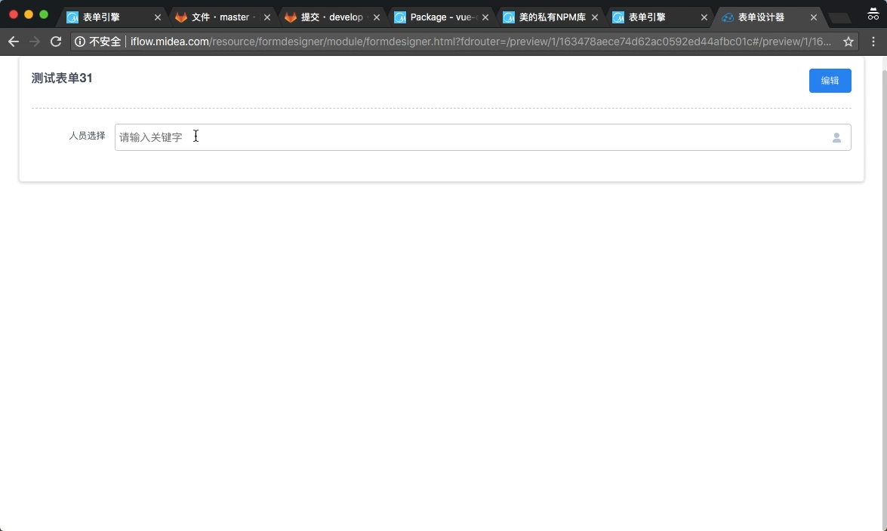
运行结果…

Slide 10
全局异步组件

Slide 11
import Vue from 'vue'
import jsDynamicLoader from 'js-dynamic-loader';
Vue.component(
'staff-selector',
() => jsDynamicLoader('http://10.17.148.25/staffSelector-V1.0.0/index.js')
);

Slide 12
ref 引用

Slide 13
<template>
<div>
<component
:is="subformComponent"
ref="subformTable"
@on-change="itemValueChanged($event.id, index, $event)"
:lang="langType">
</component>
</div>
</template>
<script>
import JSDynamicLoader from 'js-dynamic-loader';
export default {
name: "MyComponent",
data() {
return {
subformComponent: '',
};
},
methods: {
initForm() {
JSDynamicLoader('http://mippdt148_18.midea.com/static/subFormTable-V1.0.0/index.js')
.then(logicFunc => {
this.subformComponent = logicFunc;
})
.catch(e => {
console.error(e);
});
},
},
mounted() {
this.initForm();
},
};
</script>

Slide 14
UI 集

Slide 15
import JSDynamicLoader from 'js-dynamic-loader';
JSDynamicLoader("http://mippdt148_18.midea.com/static/mui/index.js")
.then(coreFunc => {
Vue.use(coreFunc);
})
.catch(e => {
console.log('加载错误...');
console.error(e);
});

Slide 16
全局异步逻辑

Slide 17
import JSDynamicLoader from 'js-dynamic-loader';
import Vue from 'vue';
import VueRouter from 'vue-router';
Vue.use(VueRouter);
JSDynamicLoader('http://js逻辑代码地址')
.then(logicFunc => {
window.LOGICFUC = logicFunc;
const routes = require('./router/router.js').default;
const router = new VueRouter({
routes
});
const App = require('./App.vue');
const store = require('./vuex/store').default;
new Vue({
router,
store,
render: h => h(App),
}).$mount('#app');
})
.catch(e => {
console.log('加载错误...');
console.error(e);
});
<script>
const {
api: {
formDesigner: {
getFormDataUrl,
},
},
services: {
formDesigner: {
validators: {
stringValodators,
},
},
},
} = LOGICFUC;
export default {
data() {
return {
};
},
methods: {
stringValodators,
getData(params) {
this.$http.get(getFormDataUrl)
.then();
},
},
};
</script>
app.js
component.vue

Slide 18
异步逻辑

Slide 19
import jsDynamicLoader from 'js-dynamic-loader';
import axios from 'axios';
export function getDataService(id) {
return new Promise((resolve, reject) => {
axios.get('http://xxxx')
.then(res => {
return jsDynamicLoader('http://xxx/index.js')
.then(asyncFunc => {
// 异步逻辑加载成功
const {dataService} = asyncFunc;
return dataService(res.data);
});
})
.then(data => {
// data 为使用异步逻辑处理好的接口数据
resolve(data);
})
.catch(error => {
reject(error);
})
});
}

Slide 20
异步样式（全局）

Slide 21
import JSDynamicLoader from 'js-dynamic-loader';
JSDynamicLoader(“http://mippdt148_18.midea.com/static/theme/dark.js”)
.then()
.catch(e => {
console.log('加载错误...');
});

Slide 22
如何打包异步组件？

Slide 23
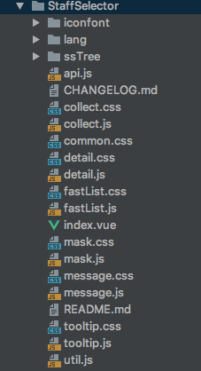
<template>
<div>
</div>
</template>
<style scoped>
@import 'common.css';
@import 'iconfont/iconfont.css';
</style>
<script>
import api from './api.js'
import util from './util.js';
import Vue from 'vue';
export default {
name: 'StaffSelector',
data() {
return {
nameText: '',
}
},
props: {
// 取消快速搜索栏
noFastBar: {
type: Boolean,
default: false,
required: false,
},
},
methods: {
calCbcListSize() {
},
}
}
</script>
就是一个普通的vue组件

Slide 24
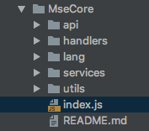
import * as api from './api';
import * as handlers from './handlers';
import * as lang from './lang';
import * as services from './services';
import * as utils from './utils';
export {
api,
handlers,
lang,
services,
utils,
}
JS 逻辑
样式
import ‘./style.less’;

Slide 25
Builder

Slide 26
style.less
index.vue
Builder
service.js
Component.zip
back.jpg
http://10.17.148.25/component-V1.0.2/index.js
Hash

Slide 27
Url: http://10.17.148.25/builder
Method: Post
Url Params:
参数名称 | 含义 | 默认值
entry | 入口文件地址 | index.vue
hash | 生成文件名 | -
Body（formData）:
参数名称 | 含义 | 默认值
source | 打包后的文件，*.zip | -
{
"status": 1,
"data": "http://10.17.148.25/subFormTable-V1.0.0/index.js",
"msg": "打包成功"
}

Slide 28
http://git.midea.com/async-components

Slide 29
Debug
anyproxy

Slide 30
npm install -g anyproxy
rule.js :
module.exports = {
summary: 'a rule to hack response',
*beforeSendRequest(requestDetail) {
if (requestDetail.url.indexOf('mseCore-V1.0.0/index.js') >= 0) {
const newRequestOptions = requestDetail.requestOptions;
newRequestOptions.hostname = '10.17.148.25';
newRequestOptions.headers.Host = '10.17.148.25';
newRequestOptions.path = '/mseCore-V1.0.0/index.js';
return requestDetail;
} },
};
anyproxy —rule rule.js

Slide 31
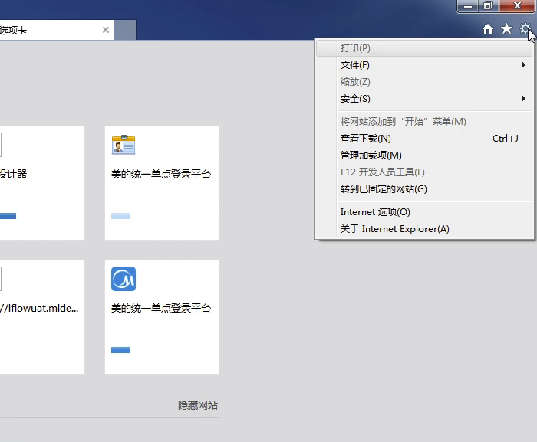
Windows

Slide 32

Mac

Slide 33
Thanks!

